Slide 1
Analyzing Agile Development
St. Louis Metro EAST .NET User Group
- Scott Kuhl
Notes:
Been doing agile for over 10 years in a variety of environments, sizes, cultures, etc.
No one does agile the same.
However you start, is not how it will work for you in 6 months.

Slide 2
Agile Manifesto
Individuals and interactions over processes and tools
Working software over comprehensive documentation
Customer collaboration over contract negotiation
Responding to change over following a plan
http://www.agilemanifesto.org/
Notes:
Why – Focus on the problem, processes were meant to solve problems. Code Complete, Clean Code – it’s the only artifact guaranteed to match reality. Satisfy the customer, don’t defend your position, only way to get repeat business. Plans don’t account for all the variables you get hit with.
Pitfalls – Upper management loves metrics and reports. Business Analysts and non-technical people can’t read code, feel might be out of a job and defend their position. Lawyers suck, contracts often trump everything to get paid. Checking off items on a plan handed out to managers looks good.

Slide 3
Personas
Fictional People Based on Real Users
Not User Stereotypes
Discovered, Not Invented
Primary Personas, Secondary Personas, Negative Personas
Name, Photo, Background, Personality, Goals
Posters, Empty Cubicles, Social Network Identities
The Inmates Are Running the Asylum, About Face – Alan Cooper
Notes:
Why – Not real users, so you don’t start building a system for one person. Not a collection of user’s with no tangible goals.
Pitfalls – Getting carried away. Focusing on what a fake person would want can lead to fake goals. Don’t ignore the requests of real users. Personas do not trust the collective voice of your users, they help define the personas.

Slide 4
Product Backlog
Ordered List of all Work
Constantly Evolving
User Stories
Enhancements
Issues
Ideas
Notes:
Why – Single place to judge long term progress. Highly visible to users so they can see the long term goals.
Pitfalls – No dependencies, must be tracked by order. Over commitment to fully defining requirements at this stage. Mess of ideas.

Slide 5
User Stories
Story:
As a [user], I want to [action], so that I can [benefit].
[Persona], wants to [action], so that she can [benefit] to [achieve goal].
Notes: Additional information to understand the story.
Tests: Flush out the notes and usage patterns.
Notes:
Why and Pitfalls on upcoming slides. These are important to get right. On par with righting the code.

Slide 6
User Story Examples
As a car salesman, I want to search for past customers, so that I can send them promotional flyers.
Need to see name and address.
Search by name
Search by distance
Search by income
Tony want to search for past customers, so that he can send them promotional flyers to afford the family trip to Disney World this year.
Need to see name and address.
Search by name
Search by distance
Search by income

Slide 7
User Story - Why?
The Goal is for everyone to understand what needs to be built and break it down into small achievable results.
INVEST: Independent, Negotiable, Valuable, Estimatable, Small, Testable

Slide 8
User Story - Pitfalls
Too Small: As a car salesman, I want to see a customer’s address when I search, so that I can send them promotional flyers.
Too Big: As a user, I want to search our data, so that I can build reports.
No One Right Method: Some smaller, some larger.
Not Use Cases: No flows, no large documents, no steps.

Slide 9
Beyond User Stories
Themes: High level objectives, goals, business level not product level
Epics: Grouping related stories, features
Wireframes: Hand drawn, simple modeling tools, not screenshots
User Interaction Diagrams:
Wireframes
Detailed Interaction
Simulated System
Notes:
Why – Large systems and complex business rules are hard to break down into small user stories. Design is VERY important since the consumerization of IT.
Pitfalls – Trying to turn Epics into old school use cases by combining user stories. Detailed design up front.

Slide 10
Enhancements, Issues, Ideas
Enhancements Are User Stories
Reference or Copy the Original User Story
Issues Reference User Stories
How is the story not meeting expectations?
Is this an enhancement?
Ideas Will Become User Stories
Notes:
Why – Often confusing on how to mix changes into new features. Its important to distinguish between the three to help the product owner prioritize.
Pitfalls – Issues often break a Sprint (discussed in next section) as they can become critical. Leave time for these or renegotiate.

Slide 11
Testing
Test All Cases Attached to New User Stories
Test All Cases Attached to Enhancements and Referenced User Stories
Create Long Term Test Plans
Automate Unit Tests
Automate Performance Tests
Automate Load Tests
Notes:
Why – Important to manage tests to reduce defects and prove user stories, but you can’t test everything every time.
Pitfalls – Tests fall in priority because of time. Tests are hard to tie back to original user stories especially in brown field development.

Slide 12
Scrum
The holy grail to all problems ever in software development

Slide 13
Overview
Develop in iterations
Lightweight
Simple to Understand
Extremely Difficult to Master
Transparent
Introspective & Adaptive
Sprint Planning Meeting
Daily Scrum
Sprint Review
Sprint Retrospective
http://www.scrum.org/Scrum-Guides
Notes:
Why – With small deadlines comes focus.
Pitfalls – Just a series of mini-waterfalls.

Slide 14
Teams
Product Owner: I say what gets built and how important it is.
Development Team: We say when it can get built.
Scrum Master: I control the chaos.
3 – 9 per team
Notes:
Why – Clearly defined roles and responsibility. Everyone is a “developer” more equal footing between BA and QA.
Pitfalls – Waterfall based teams may get defensive about turf.

Slide 15
Sprint
A fixed period of time no more than 1 month.
Sprint Goal
Planning Meeting > Daily Scrums > Development > Review > Retrospective
No changes that affect the goal.
Team remains constant.
Quality goals do not change.
Scope must be re-negotiated between the Product Owner and Development Team.
Cancelling: Product Owner, Goal Obsolete, Uncommon
Notes:
Why – More time is more pressure, people tend to procrastinate or spend too much time early getting things perfect. Goals are a good way to focus the team around a deliverable. Reduce change within the iteration to focus, so keep the iterations short to deal with change at beginning and end.
Pitfalls – Everyone works lots of hours to meet “hard estimates”.

Slide 16
Sprint Planning Meeting
Product Backlog Estimates
Kickoff Sprint
2 hours for every week in the Sprint
Self Organizing
Development Team Chooses Work Based on Product Owner Priority
Finalize Estimates
Product Owner Attends 2nd Half Only
Not enough information, Not in the Sprint
Define a Goal
Notes:
Why – Everyone negotiates to find achievable results. The group is using its collective knowledge to better understand user stories and choose work based on the best possible outcome.
Pitfalls – Management pressures the team into committing to more hours or estimating smaller numbers. Negotiations are not developers vs everyone else in a fight to do the least / most amount of work.

Slide 17
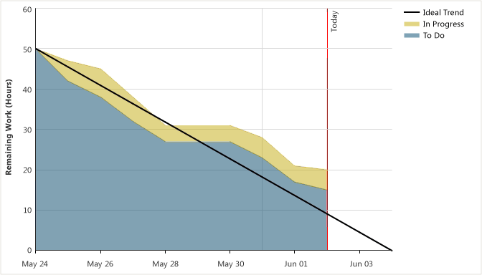
Daily Scrum
15 minutes
What did you do yesterday?
What will you do today?
What is in your way?
Chickens vs. Pigs
Sprint Burndown
Notes:
Why – Immediate feedback. Stops “slackers”. Eye on the ball.
Pitfalls – Meetings go off topic easily.

Slide 18
Sprint Review
End of Sprint
1 hour for every week in the Sprint
Demo working product to Product Owner and Stakeholders
Technical Perspective: What Went Well, What Didn’t Go Well
Evaluate Product Backlog
Discuss next Goals
Notes:
Why – Demoing product directly to customers motivates to do better. Learn from every iteration to get better.
Pitfalls – Management will try to make these shorter because they are “just demos”. Users that want to see the product are not available < don’t forget the product owner.

Slide 19
Sprint Retrospective
After Sprint Review
45 minutes for every week in the Sprint
Product Owner and Development Team
Review Sprint: People, Relationships, Process, Tools
What Went Well, What Didn’t Go Well
Improvement Plan
Re-define “Done”
Notes:
Why – Deeper review of the iteration, more candid discussions without stakeholders.
Pitfalls – Bitch session. More complaints than improvements.

Slide 20
Scrum - Pitfalls
Testing falls out of the Sprint
What is Done?
Developers pressured to add more to Sprints
Management adds work without re-negotiating
Changes (bug fixes, important people) during Sprints
Need complete buy in
Hard to get started in brownfield projects …..

Slide 21
Kanban
Scrum is for old people and is not agile

Slide 22
Overview
“Agile” Agile
No Iterations
No Estimates or Optional Estimates
No Velocity, Track Cycle Time
Transparent
Lean Manufacturing
http://agileproductdesign.com/blog/2009/ kanban_over_simplified.html
Notes:
Why – The ultimate is staying just ahead of the work. Timeboxes do not work without 100% buy in.
Pitfalls – Management does not like not having a done date.

Slide 23
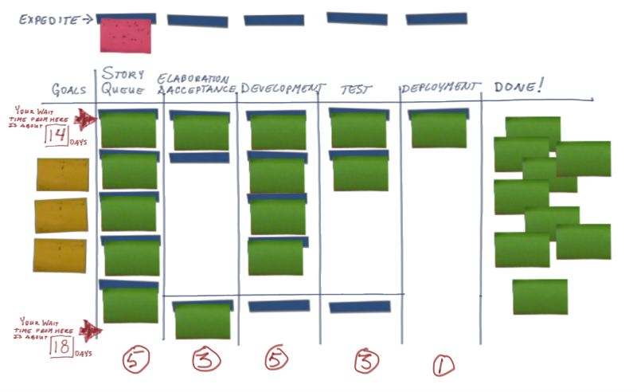
Kanban Board
Goals
Backlog (Story Queue)
Cycle Time
No Estimates

Slide 24
Kanban Board - Steps
Top = Work In Progress
Bottom = Buffer
Work In Progress
All Team Members
All Roles
Divide by 2
Starting Formula Only
Expedite
Done is Done!
Notes:
Why – Highly visible and extremely simple to track. Very flexible.
Pitfalls – Roles lock up because the people before them or behind them can’t keep up and they user the down time for other things.
Consider ready steps to track pile ups. Ex: Ready for Test pushed by developers and pulled by testers.

Slide 25
Events
Daily “Scrum”
Review Meeting: Every few weeks
Retrospective Meeting: Every few weeks
Notes:
Why and Pitfalls – All the same reasons as Scrum except for time box issues.

Slide 26
Kanban - Pitfalls
How long will this take?
Motivation loss
Coordinating releases

